Slide 1

Salary Prediction using Linear Regression
By Supriya Malakar | Techno India University

Slide 2
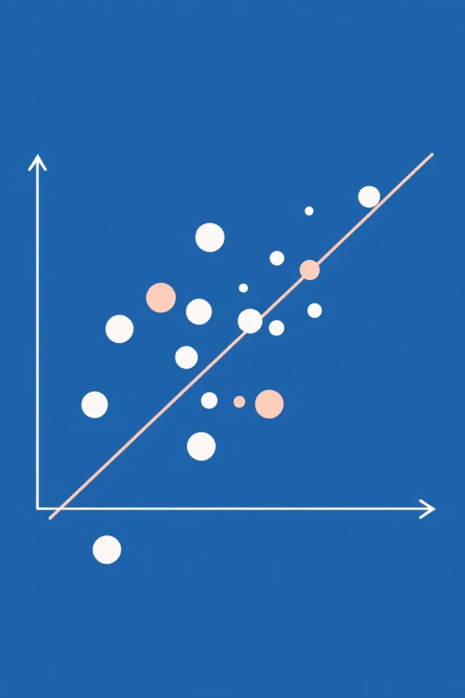




Introduction: Predicting Salaries with Linear Regression
This project leverages Linear Regression, a fundamental supervised machine learning algorithm, to predict employee salaries based on their years of experience.
Dataset Overview
The Supriya.csv dataset contains two key variables: YearsExperience and Salary.
Methodology
The model was trained using scikit-learn, following standard preprocessing, data splitting, and visualization with matplotlib.

Slide 3




Aim of the Project: From Prediction to Deployment
Our primary goal is to develop a robust regression model that accurately forecasts salaries based on employee experience.
Accurate Prediction
Build a precise model to predict salaries using years of experience as the key input.
Model Export
Export the trained model as a .pkl file for easy deployment.
Deployment Readiness
Facilitate integration with modern web applications like Flask or Streamlit.

Slide 4



Project Process: A Step-by-Step Workflow
This project follows a systematic approach to machine learning model development, ensuring robustness and deployability.
01
02
Data Collection
Importing Libraries
Gathering the initial dataset (Supriya.csv) containing experience and salary information.
Setting up the environment with essential Python libraries: Pandas, NumPy, Matplotlib, and Scikit-learn.
03
04
Data Preprocessing & Splitting
Model Training
Cleaning, transforming, and dividing data into training and testing sets for model development.
Implementing and training the Linear Regression model on the prepared data.
05
06
Model Evaluation
Saving the Model
Assessing model performance using key metrics such as R² Score and Mean Squared Error (MSE).
Serializing the trained model as salary_model.pkl for future use and deployment.

Slide 5







Essential Tools and Libraries
A comprehensive suite of Python tools powered this project, enabling efficient data handling, model building, and deployment.
Python
Pandas
The core programming language for the entire project.
For robust data manipulation and analysis.
NumPy
Scikit-learn
Providing powerful numerical operations.
The machine learning toolkit for model implementation.
Matplotlib
Pickle
For creating insightful data visualizations.
Enabling model serialization for persistent storage and deployment.

Slide 6



Model Description: Understanding Linear Regression
Linear Regression is a foundational algorithm that models the relationship between two variables by fitting a linear equation to observed data.
Linear Relationship: It assumes a linear correlation between the independent variable (YearsExperience) and the dependent variable (Salary).
Coefficient Learning: The model's training process involves determining coefficients that define the slope and intercept of the line, optimizing for the best fit.
Error Minimization: The objective is to minimize the sum of squared differences between predicted and actual values, known as minimizing the residual sum of squares.
Interpretability: Linear Regression models are highly interpretable, making it easy to understand the impact of each input variable.

Slide 7

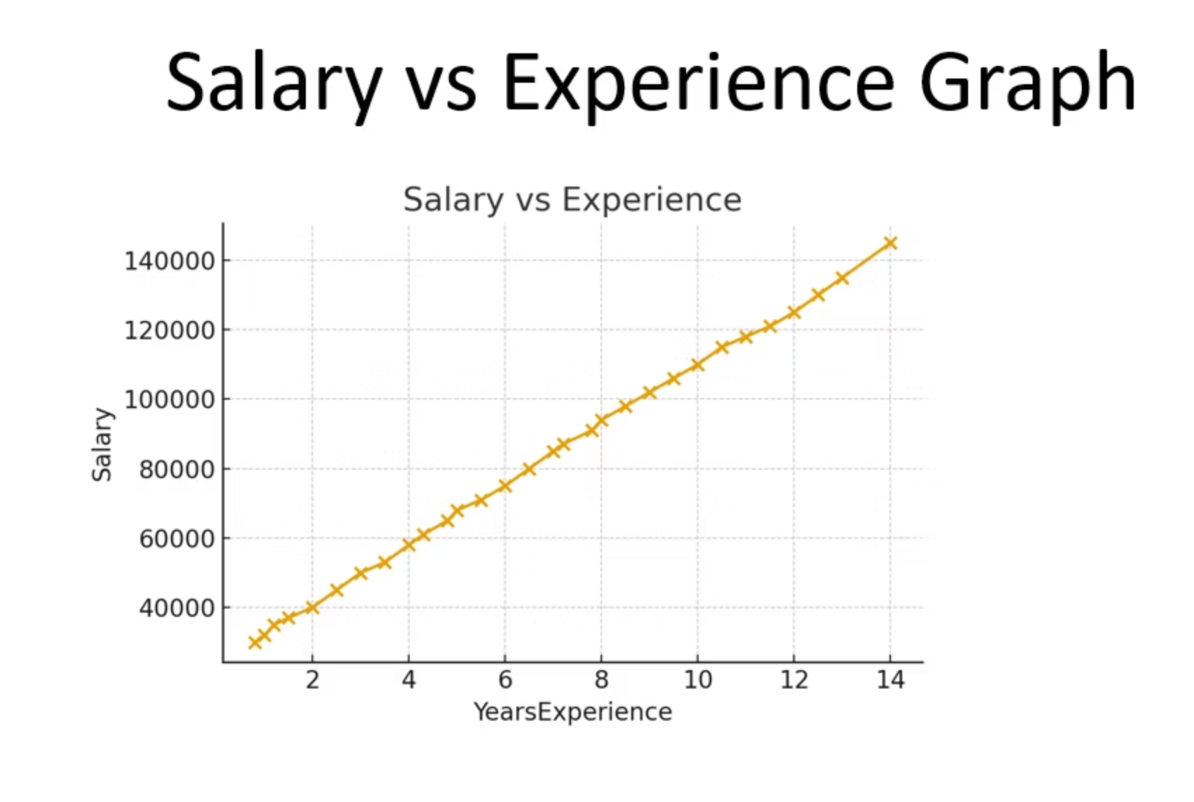



Graph Interpretation: Visualizing the Correlation
Positive Correlation
The scatter plot clearly demonstrates that salary increases proportionately with years of experience.
Strong Linear Fit
The regression line passes through the data points, affirming a strong positive linear relationship.
High Model Accuracy
Data points are tightly clustered around the regression line, indicating an excellent model fit without significant outliers.

Slide 8




Results and Evaluation: Validating Model Performance
The trained Linear Regression model delivered compelling results, confirming its effectiveness in salary prediction.
0.97
Minimal
R² Score
Error (MSE)
A high R² score signifies a strong correlation between experience and salary, demonstrating the model's predictive power.
Low Mean Squared Error indicates that the model's predictions are very close to the actual salaries.
The regression line's close alignment with the data points further validates the model's robust performance and accuracy.
The trained model is successfully stored as salary_model.pkl, ready for immediate deployment and integration into various applications.

Slide 9

Conclusion:
The Salary Prediction Model built using Linear Regression demonstrates an effective and reliable approach for estimating employee salaries based on years of experience. The scatter plot and regression line show a strong positive relationship, confirming that as experience increases, salary also tends to rise in a predictable manner. The close alignment of data points with the regression line indicates minimal variance and validates that the model fits the dataset well. Metrics such as the R² score further reinforce the model’s accuracy and its ability to generalize to unseen data.
Overall, this project successfully showcases the complete workflow of a machine learning regression model—from data preprocessing and visualization to training, evaluation, and deployment using a .pkl file. The simplicity and efficiency of Linear Regression make it a suitable choice for this type of prediction task. With further improvements, such as adding more features or applying advanced algorithms, the model could be expanded for real-world HR analytics, salary planning, and decision-support applications.

